Slide 1
BOLECHOWO – The DHN of Tomorrow

Slide 2
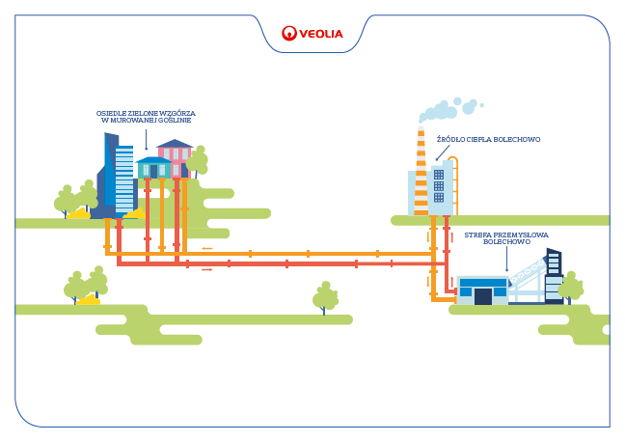
Bolechowo today – 100% coal-depended system
Installed power: 18 MW
Ordered power : 13.6 MW
Network length: 12.0 km
Heat sales: 70 600 GJ/a
Fuel structure: 100% coal
Housing estate Zielone Wzgórza in Murowana Goślina
Heating plant in Bolechowo
Industrial zone in Bolechowo

Slide 3
Environmentally friendly Partnership
Aquanet –
municipal company;
provides water and sewage services for Poznań and 17 neighboring municipalities (800,000 residents),
annual turnover – 116.3m EUR,
net profit – 22.1m EUR.

Slide 4
Project overview
Market to preserve the existing customers (Solaris – 40% of heat sale) Additional sales of heat and services
Innovation
combining the energy, water and sewage sectors
Transformation
of the coal system in into an energy efficient system
EU Grant
(3,81 MPLN) last grant up to 2020; no profitability without subsidy
The project:
increases the supply guarantees expected by the market,
reduces the carbon share, and
ensures a good margin

Slide 5
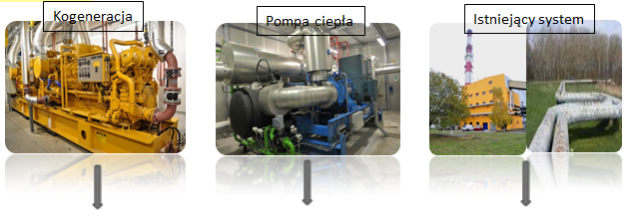
The key elements of the new system of Bolechowo-Szlachęcin
Cogeneration
Heat pump
Existing system
Electrical power: 1.02 MWe
Thermal power: 1.05 MWt
Energy production: 7 700 MWh/a
Heat production: 28 647 GJ/a
Heat pump power: 1.70 MW
Power of lower source: 1.07 MW
Lower source temp. : 8/3^{O}C
Electric propulsion: 660 kWe
COP: 2.58
Heat production: 38 345 GJ/a
Max. power in winter – 9.2 MW
Max. power in summer – industry 1.1 MW; the city 1.5 MW
Heat sales 2016: 71 362 GJ/a
Production 2016: 93 680 GJ/a
Development potential: 10 000 GJ/a

Slide 6
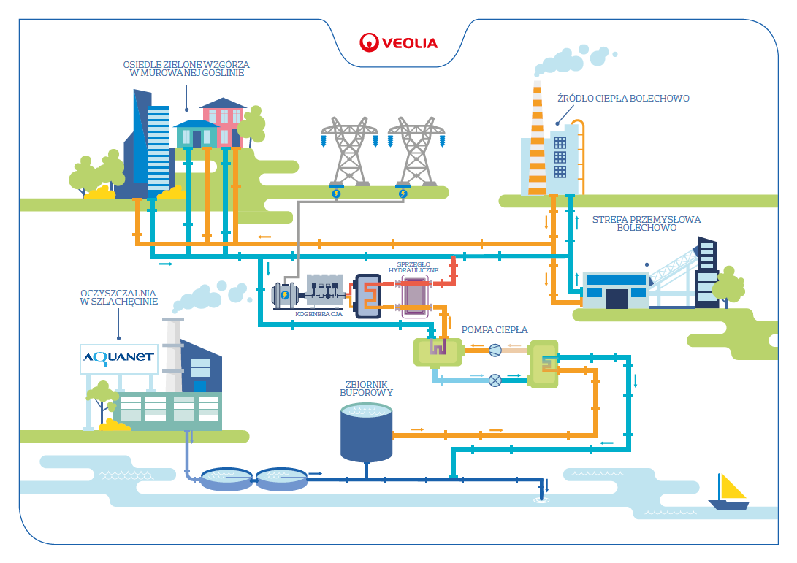
The DHN of Tomorrow – wastewater as a source of green energy
Housing estate „Zielone Wzgórza” in Murowana Goślina
Heating plant in Bolechowo
Industrial zone in Bolechowo
hydraulic clutch
Wastewater treatment plant in Szlachęcin
Heat pump
Buffer tank

